Slide 1
Planning
Olivier Liechti & Simon Oulevay
COMEM Web Services 2016

Slide 2

Objectives

Slide 3
Objectives for the course
Understand the generic concept of “Web Service”.
Understand that “RESTful APIs” are one way to expose web services.
Be able to explain the core principles of the REST architectural style
  Resource identification & URLs
  HTTP verbs
  Content-negotiation & resource representation
Learn how to implement a RESTful API in JavaScript

Slide 4

Theme

Slide 5
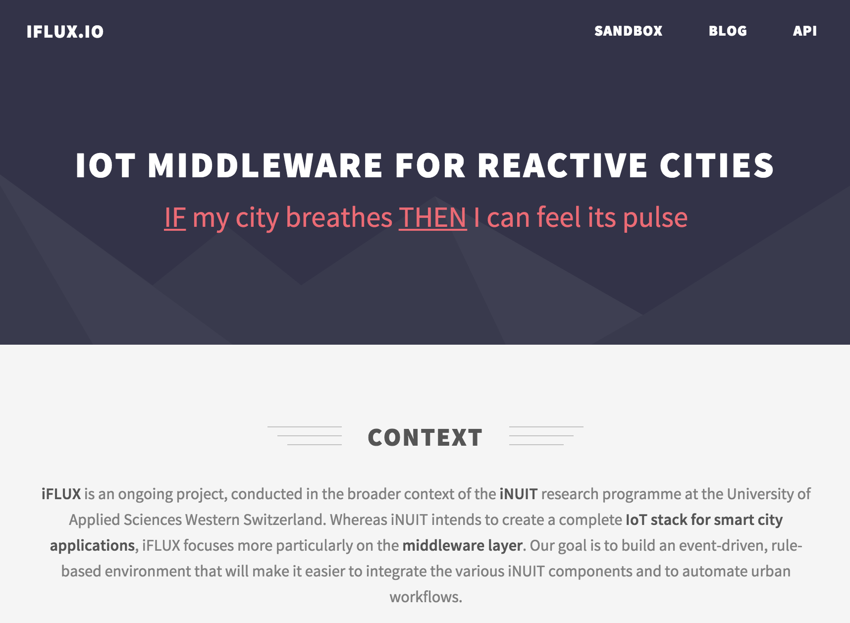

Slide 6
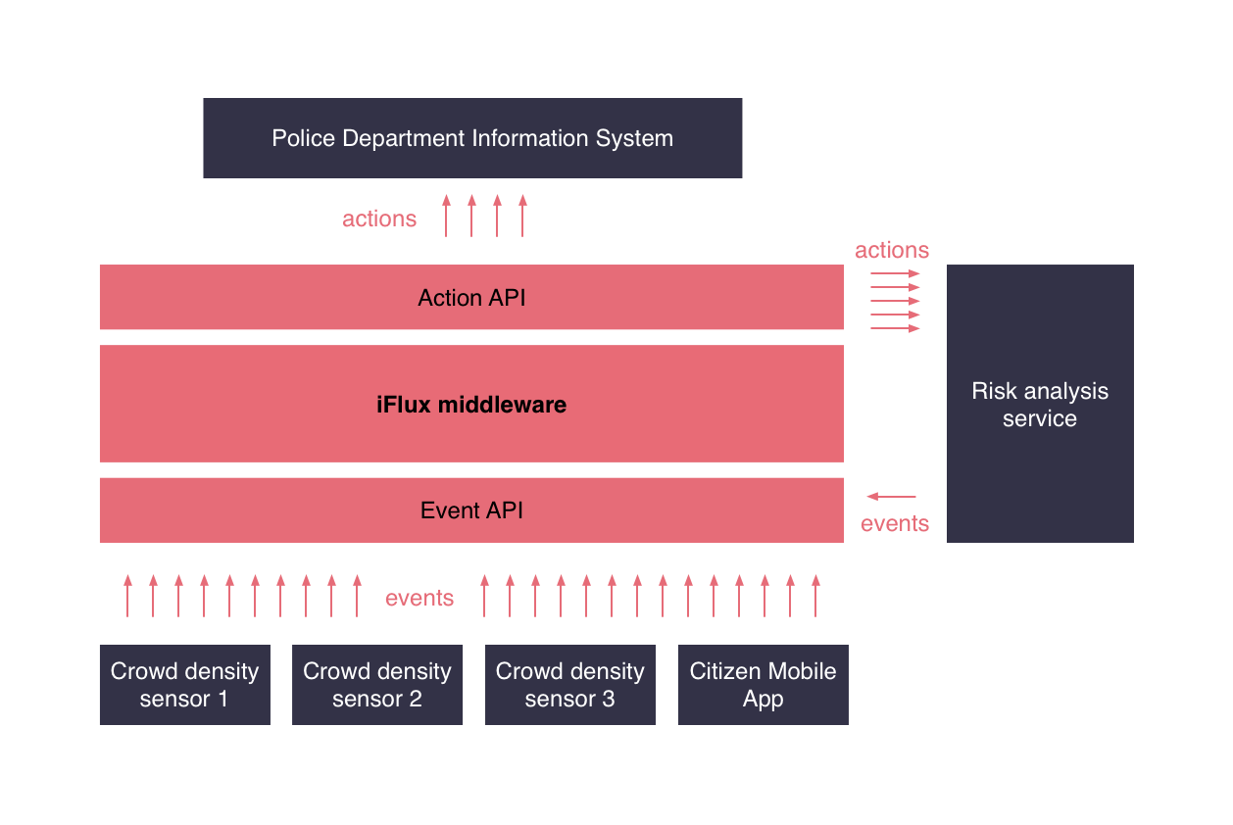

Slide 7
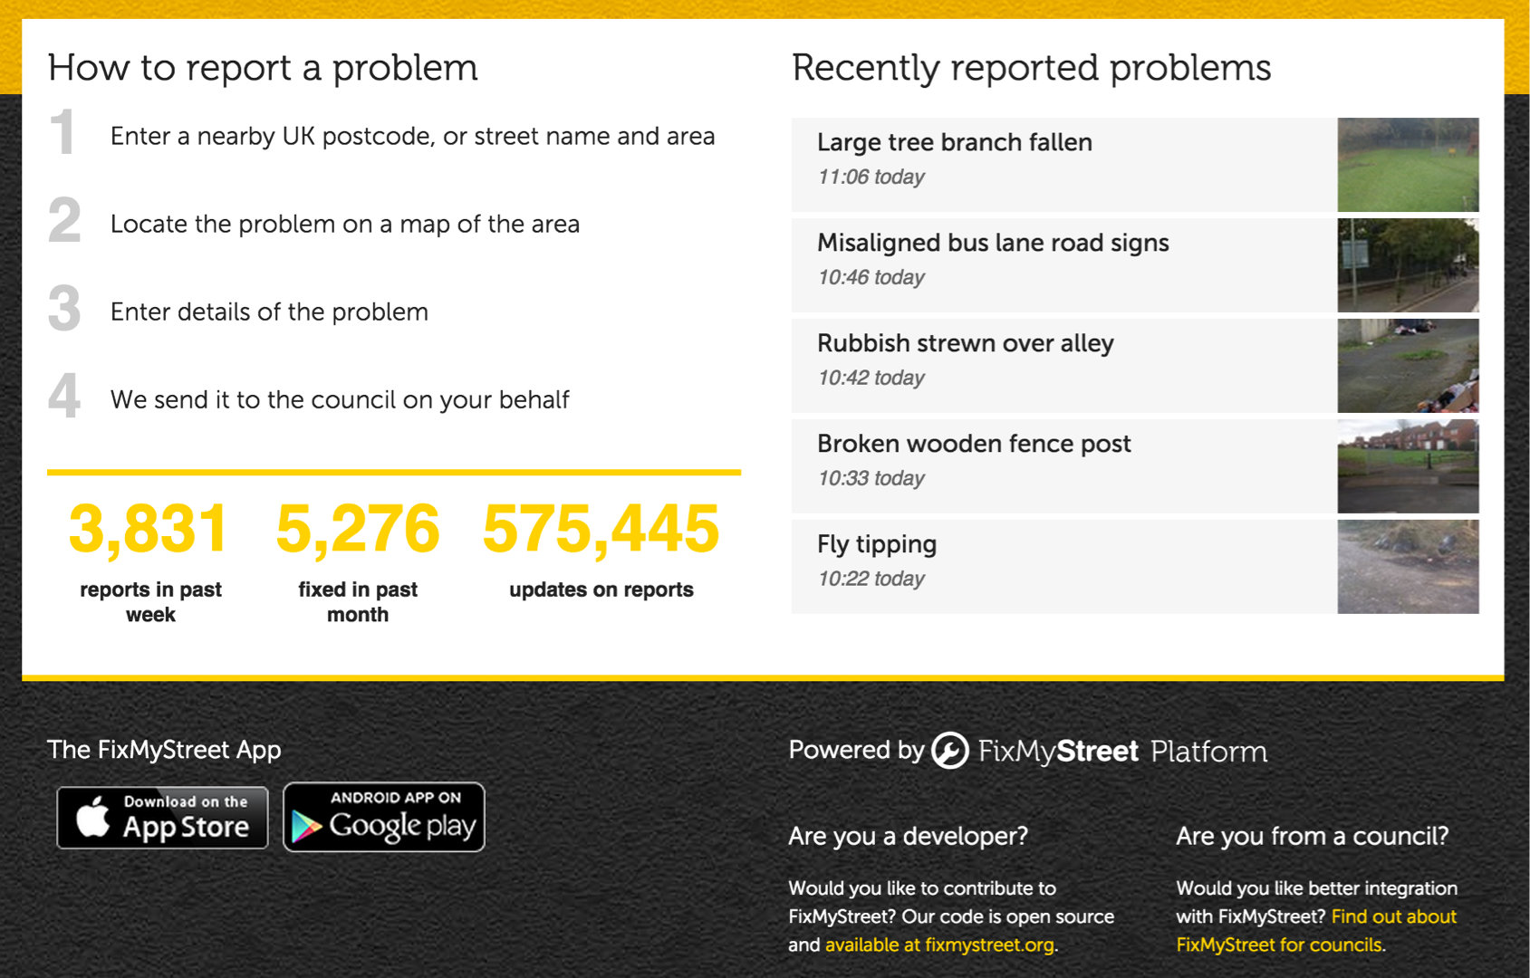
Citizen Engagement

Slide 8
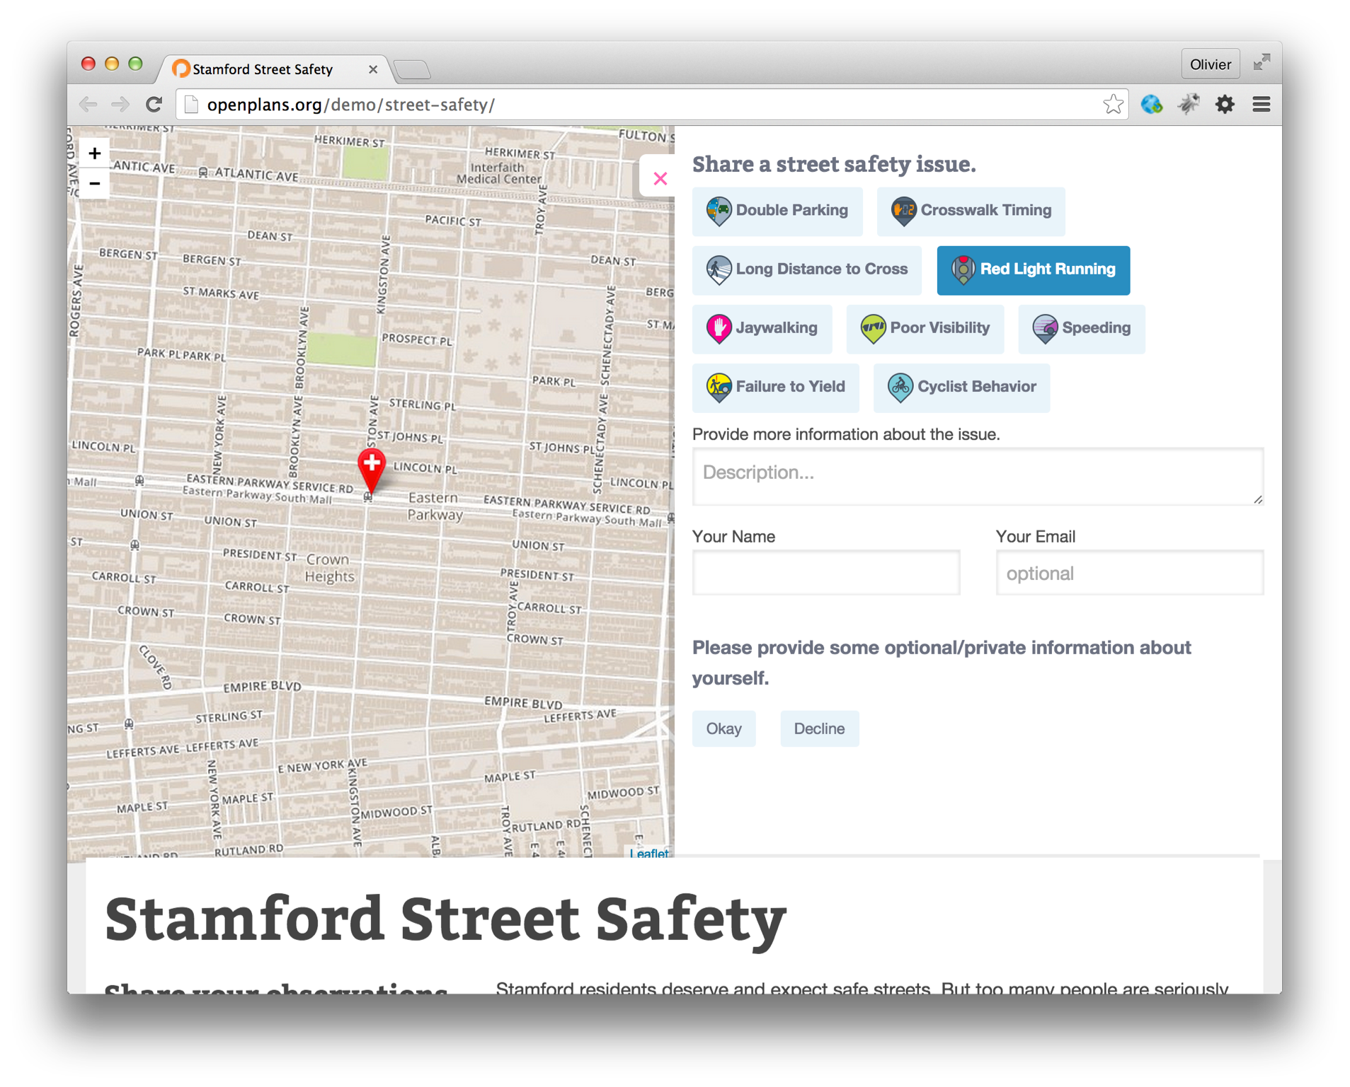

Slide 9
Theme
Foster citizen engagement, by making it possible and easy for people to raise issues and give feedback to local authorities. To illustrate the point, think of a mobile app that city inhabitants could use to report a broken streetlight, a dangerous crossroad or a critical situation. In iFLUX terms, citizen become event sources (the mobile app is a user agent that provides an interface to the system). Every issue raised by a citizen becomes an event, that can trigger actions based on configured rules.

Slide 10
Specifications
http://www.iflux.io/blog.html

Slide 11

Planning & Guidelines

Slide 12
Tuesday | Wednesday | Thursday | Friday
Introduction to REST APIs | REST API principles, domain model, documentation | Deployment | Coding
Installation of tools | Coding | Coding | Demo

Slide 13
Today
Introduction
Big Web Services vs REST Core REST concepts and principles
JavaScript, Node.js & npm
Implementing a REST API (Express.js, MongoDB, Mongoose)

Slide 14
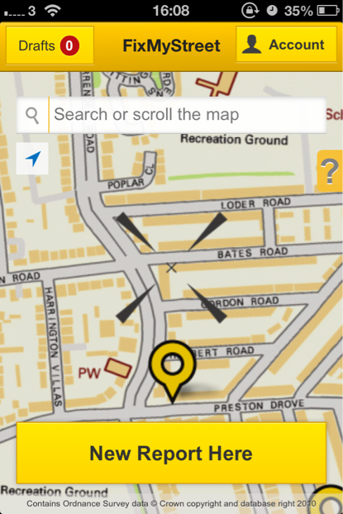
Web Services
Course
Mobile App
Course

Slide 15
APPMOB: CityZen

Slide 16
Guidelines & delivery
You will work in groups of up to 4 people
You will implement a REST API that follows the functional specification described in the iFlux blog post
You will document this REST API
You will deploy this REST API and its documentation on the Heroku platform
You will be graded on the following criteria:
  Adherence to REST principles and consistency of the implementation
  Quality of the implementation and respect of the conventions of the languages and tools used (JavaScript, Node.js, Express.js, etc)
  Quality of the REST API documentation

